Slide 1
Serial Interface
Considered to be one of the most basic external connections to a computer, the serial port has been an integral part of most computers for more than 20 years. Although many of the newer systems have done away with the serial port completely in favor of USB connections, most modems still use the serial port, as do some printers, PDAs and digital cameras.
Essentially, serial ports provide a standard connector and protocol to let you attach devices, such as modems, to your computer.
Notes:
A personal digital assistant (PDA), also known as a handheld PC,^{[1][2]} is a mobile device that functions as a personal information manager. PDAs were largely discontinued in the early 2010s after the widespread adoption of highly capable smartphones, in particular those based on iOS and Android.^{[3]}

Slide 2
Serial Interface(Cont..)
The name "serial" comes from the fact that a serial port "serializes" data. That is, it takes a byte of data and transmits the 8 bits in the byte one at a time.
The advantage is that a serial port needs only one wire to transmit the 8 bits (while a parallel port needs 8). So to send data in long distance it may be converted in serial form.
The disadvantage is that it takes 8 times longer to transmit the data than it would if there were 8 wires. Serial ports lower cable costs and make cables smaller.

Slide 3
Serial Interface(Cont..)
Data is moved in parallel within a computer.To interface a computer with serial data lines, the data must be converted to and from serial form.
A parallel-in-serial out shift register and a serial-in-parallel out shift register can be used to do this.

Slide 4
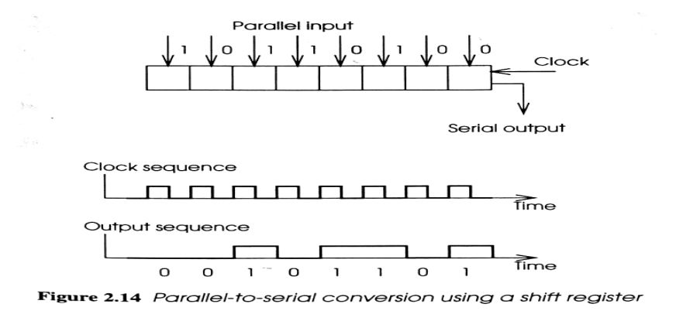
Parallel-Serial Conversion
For Transmission, parallel data word is loaded into the shift register.
A pulse on the clock input causes the data to be shifted.
For an n-bit data word n clock pulses will output the word in serial form.

Slide 5
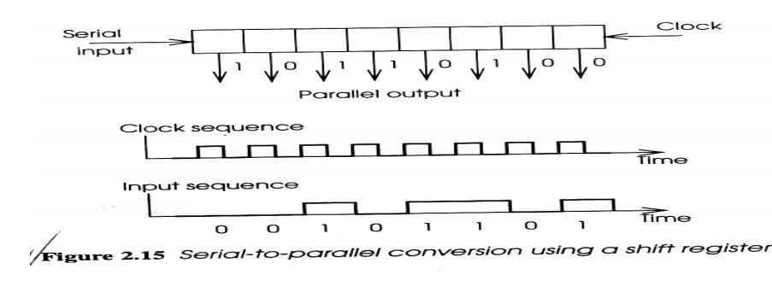
Parallel-Serial Conversion(Cont..)
Reception of the serial data is performed by another shift register, in a serial-to-parallel convertor.
•A sequence of n clock pulses causes the input to propagate along the shift register until it is all available in parallel.
•The first bit to arrive is shifted all the way through the shift register and appears at the right hand end.

Slide 6
END..

